Slide 1
Module 44: Creating Assignment Rules
Siebel Core Developer and Technology School
Notes:
Time: Lecture: 30 – 35 minutes; labs: 35 minutes
Intent: To explain how to create and test assignment rules.
Flow: Create rules that represent sales territories. Create rules that evaluate skills. Test rules and examine log files.
Key Terms:
Rules
Criteria
Candidates
Skills
Please note: Faculty-specific notes are italicized.

Slide 2

Module Objectives
After completing this module you will be able to:
  Create assignment rules
  Test assignment rules
Why you need to know:
  Assignment Manager uses rules to assign data to candidates
Notes:
Each objective and “why you need to know” should be stated aloud.

Slide 3
Assigning Data by Sales Territory
0/4
Design Assignment Rule
Create Rules
Define Criteria
Specify Candidates
Notes:
This is a structuring slide; the following slides cover the steps and concepts in detail.

Slide 4
Design Assignment Rule
1/4
Design the criteria that represent each territory
Identify the candidates who to be assigned data within each territory
Rule: Western Opportunities
Rule: Eastern Opportunities
Object: Opportunities
Object: Opportunities
Criteria: Account State = CA
Criteria: Account State = MA
Candidates:
Sales Rep – West
Sales Organization
Candidates:
Sales Rep – East
Sales Organization
Notes:
This is a recap of a rule from the previous module.

Slide 5
Create Rules
2/4
Select Site Map > Administration – Assignment > Assignment Rules List
  Select the Assignment Object(s) to be assigned by this rule
  Set Person Candidate Source to "From Rule“
Add your rule to a rule group
  Every rule must belong to one and only one rule group
  For implementations that do not utilize rule groups, all rules can be in the Default Rule Group
Notes:
If you fail to select an assignment object, the rule is applied to all objects. This impacts performance, and is not recommended. While a rule could pertain to more than one object at the same time; for example, opportunities and accounts, they would not want to apply it to all.

Slide 6
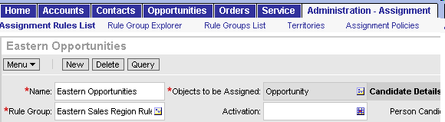
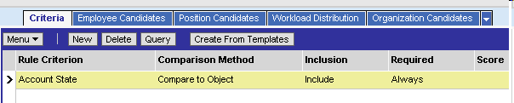
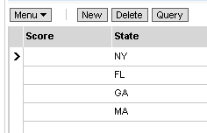
Define Criteria
3/4
Drill down on the rule to add Criteria
  There are many predefined Assignment Criteria
Select the Rule Criteria to be used to assign data
Select the Comparison Method to specify what the criteria are being compared to
Specify the values against which things are being compared
Notes:
Each assignment criterion requires a comparison method.
A reason why you would set Required to Never: by using non-required criteria with scores, you can add a higher score to candidates who satisfy these criteria, while keeping candidates who do not satisfy these criteria.
Criteria are really the basis of an assignment rule. They are the constraints that are applied to a rule, the conditions that must be met in order for the candidates to be considered for assignment. Criteria define a base condition, and the criteria values further define what is to be compared between assignment objects (work) and candidates (people).
If Required is set to Always, the assignment object or the candidate (or both) must meet the criteria to qualify for assignment. This setting is like a flag that indicates, “Always use this criterion in determining assignments.” There might be five different criteria that make up a rule. If Required is set to Always, then all five criteria must be met for an assignment to be made.

Slide 7
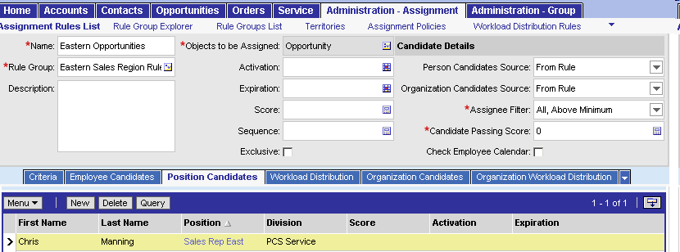
Specify Candidates
4/4
Select the Position Candidates view to specify the positions to be assigned if the rule passes
If organizations are to be assigned by your rule, specify them in the Organization Candidates view
Notes:
Users define the potential candidates for assignment by associating employees, positions, or organizations to the assignment rule. They use Assignment Employees, Assignment Positions, and Assignment Organizations to do this. If they check the All People box for the rule, they do not need to specify assignment positions, because it searches all positions in the database.
Part of the process of setting up Assignment Manager is to determine who to assign. For team-based assignment objects, users must indicate which positions are to be considered for an assignment. For owner-based assignment objects, users must indicate which employees are to be considered for assignment. In simple terms, this is like saying, “These are the positions or people I want as potential candidates for this account, opportunity, service request, and so forth.”

Slide 8
Assigning Data by Skill
0/5
Design the Assignment Rule
Create Rules
Define Criteria
Specify Candidates
Associate Skills to Candidates
Notes:
This is a structuring slide; the following slides cover the steps and concepts in detail.

Slide 9
Design the Assignment Rule
1/5
Design the criteria to be used to match candidates to data
Specify the candidates for Assignment Manager to consider
Rule: Assign Service Requests
Object: Service Request
Criteria: Product
Candidate: All People
Notes:
This is a recap of a rule from the previous module.

Slide 10
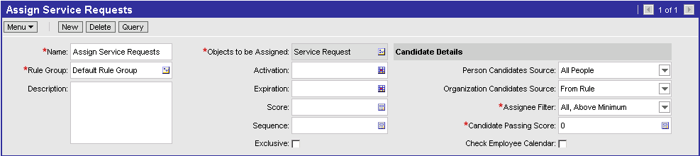
Create Rules
2/5
Select the Assignment Object(s) to be assigned by this rule
Set Person Candidate Source to "All People“
Add rule to a rule group
Notes:
Person Candidates Source can be set to two other values, Activity Account Team and Activity Asset Team. These are known as “dynamic candidates”.
Dynamic candidates are only configured for Activities in the standard Siebel application, and only for their relationships to accounts and assets. Dynamic candidates can be configured for other objects. Contact Expert Services for more information.
An example of dynamic candidates:
For a rule that assigns Activities, if the Person Candidates Source is set to Activity Account Team, Assignment Manager evaluates the Account associated with the Activity, identifies the members of the Account Team for that Account, and makes those Employees candidates for the Assignment Rule. There are also specific criteria built for supporting dynamic candidates such as Account Team Relation Type. These criteria are not commonly used.
This functionality is described in greater detail in the Assignment Administration Guide in Siebel Bookshelf

Slide 11
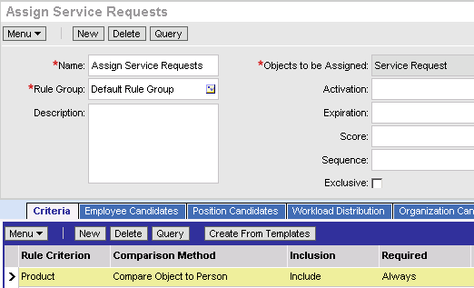
Define Criteria
3/5
Drill down on the rule to add Criteria
  There are many predefined Assignment Criteria
Select the Rule Criterion to be used to assign data
Select the Comparison Method to specify what the criterion is being compared to
Notes:
Each assignment criterion requires a comparison method. Compare Object to Person criteria compare the record that is being assigned to the skills of the candidates.
Compare Object to Person criteria can cause performance issues if used against large volumes of data or large numbers of candidates. Criteria that is met by large numbers of candidates, such as Language, can worsen the performance impact.

Slide 12
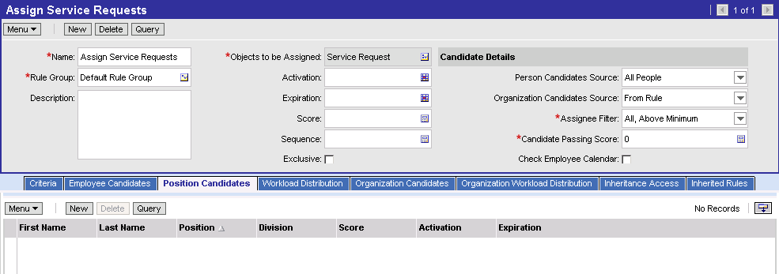
Specify Candidates
4/5
When the Person Candidate Source is set to "All People", every one is a candidate
  Instead of specifying a list of candidates for the rule
Assignment Manager uses Compare Object to Person and Compare to Person criteria to assign data to skilled candidate(s)
Leave Position Candidates empty
Notes:
By specifying All People, everyone is a candidate of the rule. Assignment Manager will then use Compare Object to Person and Compare to Person criteria to narrow the list of candidates.

Slide 13
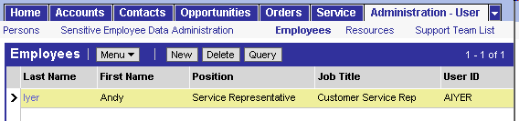
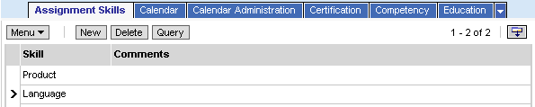
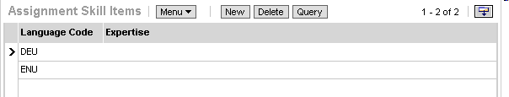
Associate Skills to Candidates
5/5
Skills define what types of data should be assigned to each candidate
  Select Site Map > Administration - User > Employees > Assignment Skills
Notes:
Other types of candidates can also have skills. Navigate to Administration – Groups > Positions > Position Skills or Administration – Groups > Organizations > Organization Skills to set skills for Positions and Organizations.

Slide 14
Testing Assignment Rules
0/4
Configure Assignment Event Logging
Release Assignment Rules
Run Batch Assignment
Inspect Assignment Log Files
Notes:
This is a structuring slide; the following slides cover the steps and concepts in detail.

Slide 15
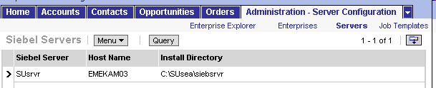
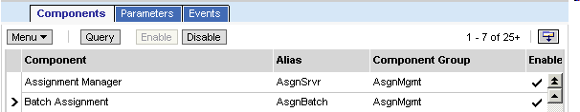
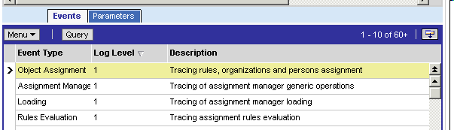
Configure Assignment Event Logging
1/4
Event Logging is used as an aid in debugging assignment rules
  Set log levels for Object Assignment and Rules Evaluation
    Log levels range from 0 to 5; 5 provides the most detailed information
    A log level of 4 provides good details for testing
Notes:
Event Logging can be set for many server components. The values range from 0 (fatal errors only) to 5 (diagnostic). The event-logging level of 4 provides detailed information about the task’s execution—in this case, the evaluation of rules and assignment of candidates.
While it is common to set these values on the Batch Assignment component, it is common to set lower values on the Assignment Manager component to improve performance.

Slide 16
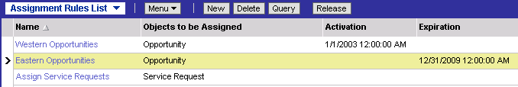
Release Assignment Rules
2/4
Release the rules once they are defined
  Click the Release button to refresh the list of rules used by Assignment Manager
Assignment Manager acts on activated released rules
  Rules are considered inactive if they have an expiration prior to, or an activation after, the current time
  If you modify rules, you must release them again
All of these Rules are active
Notes:
Unreleased rules are ignored by Assignment Manager. Changes made to a rule since it was last released are ignored by Assignment Manager.

Slide 17
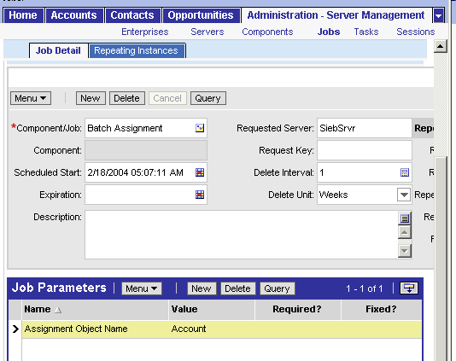
Run Batch Assignment
3/4
Select Site Map > Administration – Server Management > Jobs
Create a Batch Assignment job
  Specify the Assignment Object Name, for example, Account
Notes:
This was previously covered in the Server Administration section of the class.

Slide 18
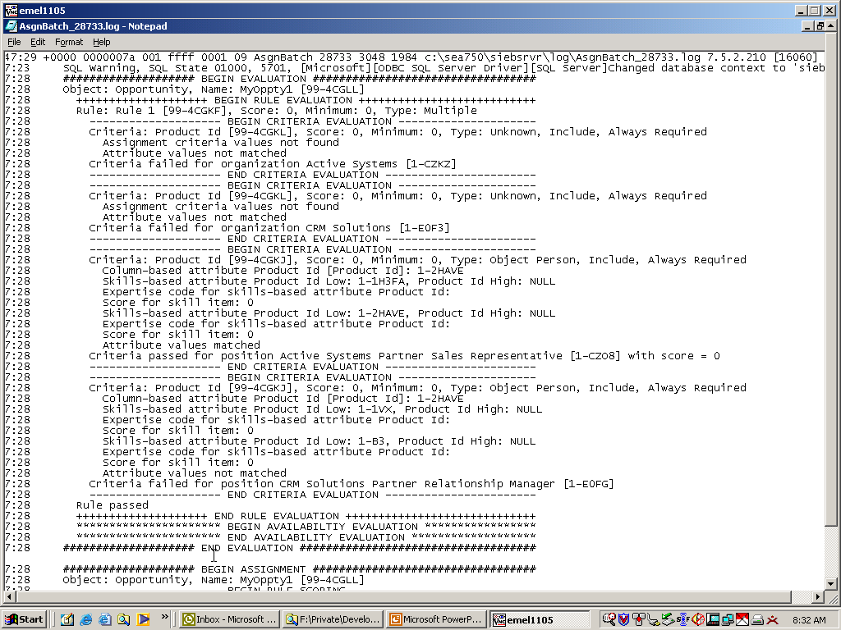
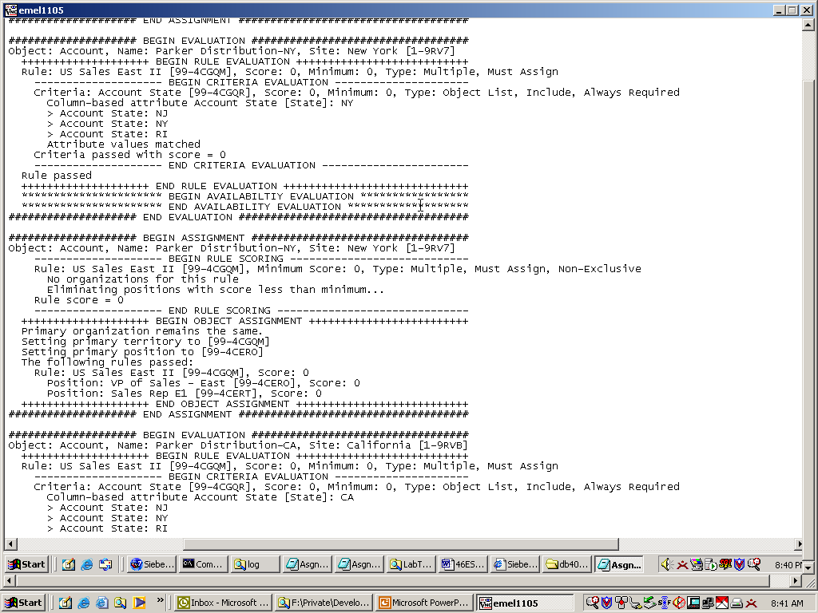
Inspect Assignment Log Files
4/4
Log files are located in the Siebel Server log directory
  Generated after Batch Assignment is started
Detailed log files provide valuable information
Rule criteria
Candidates
If criteria passes evaluation, object is assigned
Notes:
Step through the Rules Evaluation section of the log file, examining the rules that were evaluated, the criteria that were compared, the actual values on the record being assigned, and the rules that pass.
Step through the Object Assignment section of the log file, examining the rules that pass, the candidates that pass from the rules that pass, and the actual assignments.

Slide 19
Summary
This module showed you how to:
  Create assignment rules
  Test assignment rules
Notes:
Review Question: What are the values for the comparison method of a criterion?
Answer: Compare to Person, Compare Object to Person, Compare to Object, Compare to Organization, and Compare Object to Organization

Slide 20
Lab
In the lab you will:
  Create an assignment rule group and assignment rules for assigning the previously imported accounts
  Create employee skills for service representatives
Notes:
See lab for detailed instructions.

